Slide 1
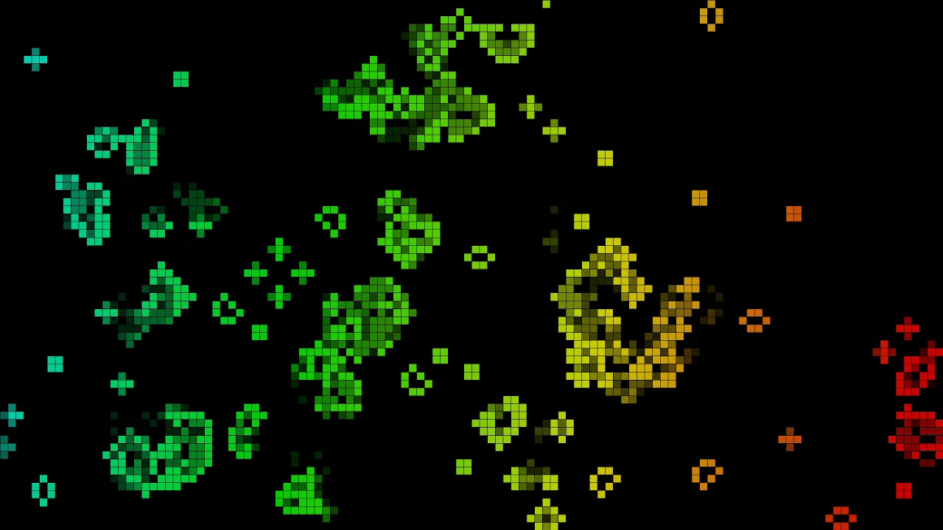
















Conway’s Game of Life

Slide 2

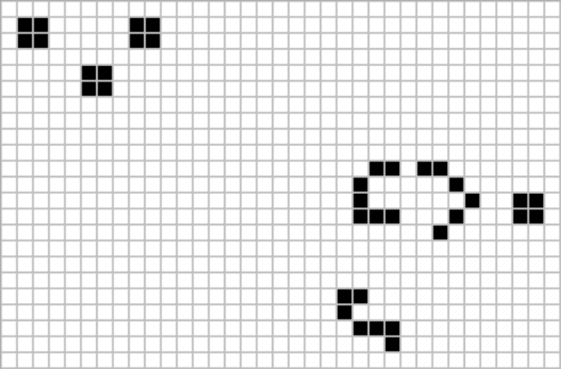
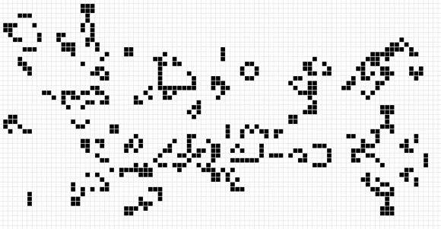
What is Conway’s Game of Life?
Cellular automaton
A cell is defined relative to its neighbours
A fixed set of rules dictates how the cells will interact through generations
Zero-player game
Only way to change its outcome is to change the original configuration

Slide 3
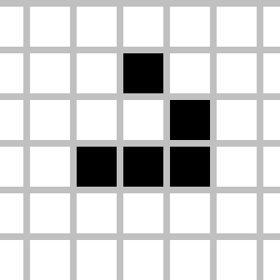
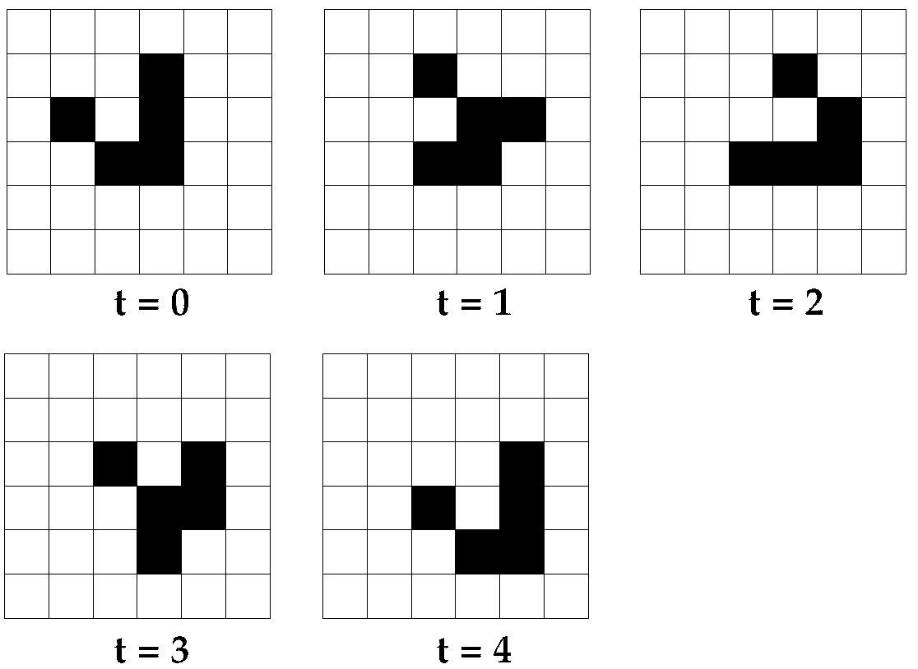
What is Conway’s Game of Life?
The Rules:
“The Gilder” is an arrangement which results in infinite generations
Any live cell with fewer than two live neighbours dies, as if by underpopulation,
Any live cell with two or three live neighbours lives on to the next generation,
Any live cell with more than three live neighbours dies, as if by overpopulation,
Any dead cell with exactly three live neighbours becomes a live cell, as if by reproduction.

Slide 4
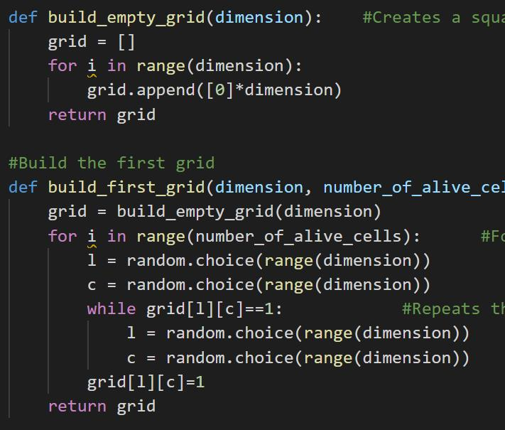
Building the Grid
The build_empty_grid function takes one parameter, called dimension
A for loop runs as many times as many as is specified in range(x), with x being dimension in this case
The function returns a grid filled with 0s with both the grid length and width equal to the argument passed in the parameter dimension

Slide 5
Building the Grid
The build_first_grid function which takes two parameters: dimension and number_of_alive_cells
It returns a grid with the dimension, containing as many 1s (live cells) in the grid, as is number_of_alive_cells
A for loop with the range of number_of_alive_cells picks 2 random numbers using the .choice() function from random.
It numbers as index references for where it attempts to put a 1
If a 1 is already there, a while loop repicks a spot to place it
Function returns the new grid which now has both 0s and 1s in random positions

Slide 6
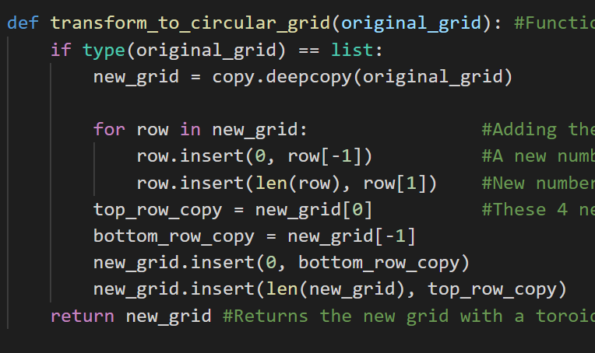
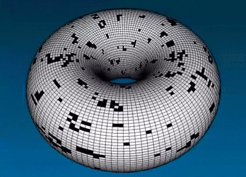
Challenges with the Grid
How should the cells at the borders behave?
Border cells don’t have the total 8 neighboring cells
Either they should be replaced by dead or live ones
Using transform_to_circular_grid, the grid is transformed into a torus
All the extremities are copied and inserted in the grid
Bottom row is copied and inserted at the top
Sides are inserted to the other side

Slide 7
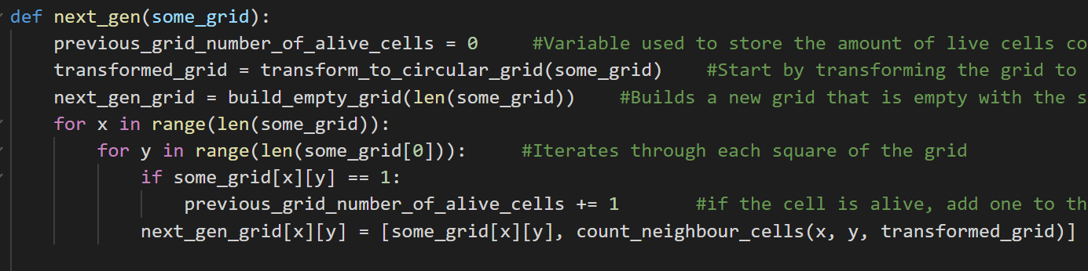
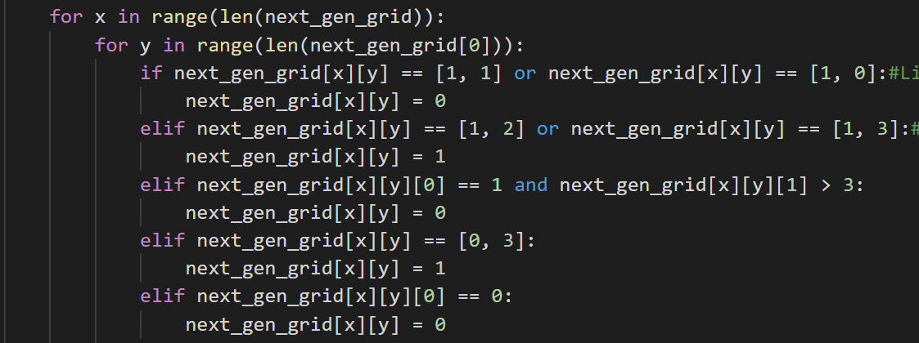
Building the next Grid
Next generation of a cell population determined using the next_gen function
Next_gen function takes only a cell grid as an argument
Next_gen function also counts how many live cells there are in the grid passed as an argument
Returns two variables: The number of live cells in previous grid, and the grid with the new population
When returning two variables from a function, it is in list-form

Slide 8
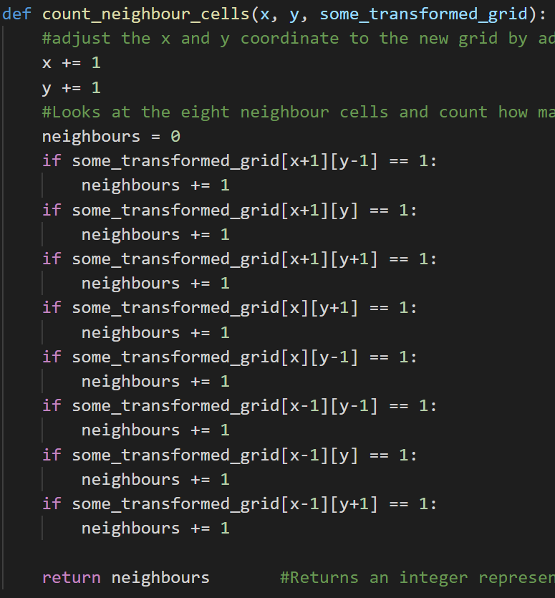
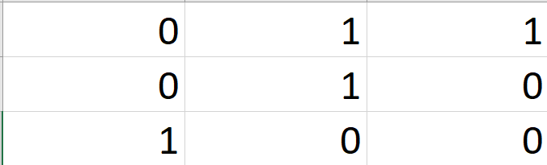
Building the next Grid
According to the rules of the Game of Life, two pieces of information are needed to determine the state of the next generation's cell at that same index
The state of the cell at that index in the previous grid, and how many neighbours it had
To count how many neighbours a cell has, we create a new function, called count_neighbour_cells, taking three parameters
The x- and y-position of a cell, and a transformed grid. What we mean by transformed grid, is one that has been made into a torus using the transform_to_circular_grid
The function checks all the nearby cells in a 3x3 square and returns a count of how many of those were live cells
Middle cell has 3 "neighbours"

Slide 9
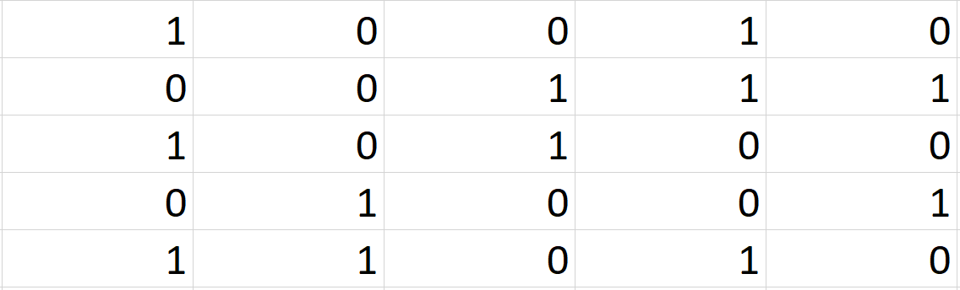
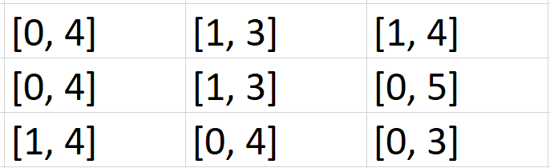
Building the next Grid
Previous_grid_number_of_alive_cells set to 0;
Creating a next_gen grid containing only 0s;
and a transformed_grid – a result of the grid being passed as an argument in the transform_to_circular function.
Now using two for-loops, we iterate through each cell in the previous grid.
For each index, a list is created at that same index in the empty next_gen_grid containing the state of the previous cell, and how many neighbours it had.
If a cell is alive, 1 is also added to the previous_grid_number_of_alive_cells counter.

Slide 10
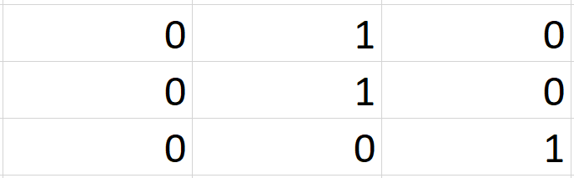
Building the next Grid
Now the next_gen_grid filled with the lists at each cell index, now gets iterated through, and the rules of the game are applied.
For example, if an index was a [1, 2], it now becomes a 1.
This is done for each index, and so, the next population has been generated.
The function returns a count of the number of live cells in the previous grid, and the new grid.

Slide 11
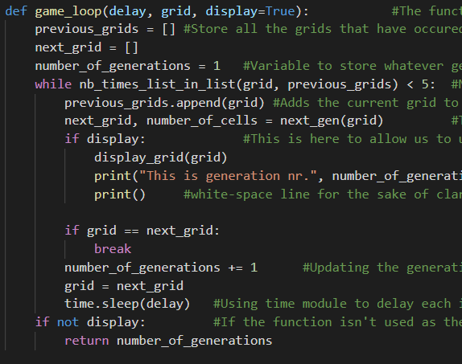
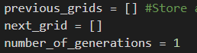
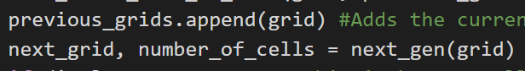
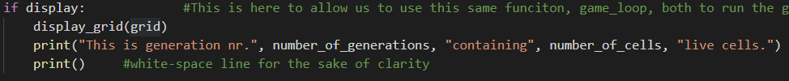
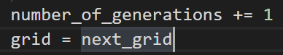
How does the game run?
Game_loop function that takes three inputs
We start by declaring several variables:
In each iteration the grid is added to the list of former grids, the next population is determined as well as the number of cells alive in the current grid
If “display” is True, code displays grid in console
Grid is set to be equal to the next_grid
Between each iteration there is a delay, as determined by the “delay” parameter
Using sleep() function from time-library to make the delay

Slide 12
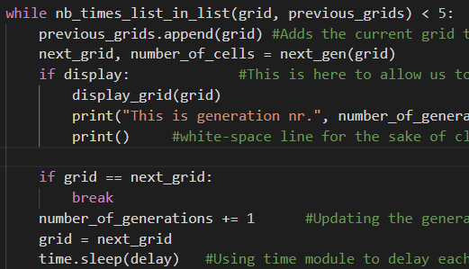
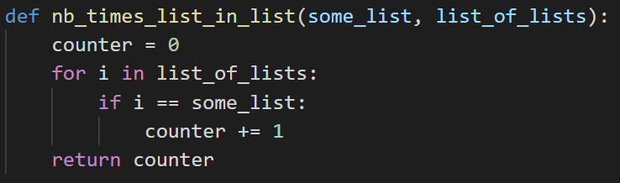
How does the game run?
Case a)
Next is the while loop which iterates until, either a) that the grid that is about to be shown has already been seen 5 times, or b) the next generations grid is equal to the next grid
If b is the case, an if condition using the break statement, stops the while loop
To determine whether the grid has already been seen, we use our nb_times_list_in_list function
Function loops through previous_grids variable using a for-loop, checking if the current grid is in it. If so, adds 1 to the counter
Returns counter after it’s done with the for-loop
Case b)

Slide 13
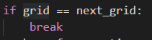
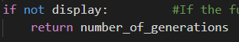
How does the game run?
A stable state we define, in our code, implicitly as one where a population either reaches a point where it stays the exact same
Or a state where it is infinitely repeating
Code determines that a population is infinitely repeating, if that same grid has already been there 5 times
If the “display” parameter isn’t set to True, the function returns the number of generations the population underwent before it reached its stable state

Slide 14
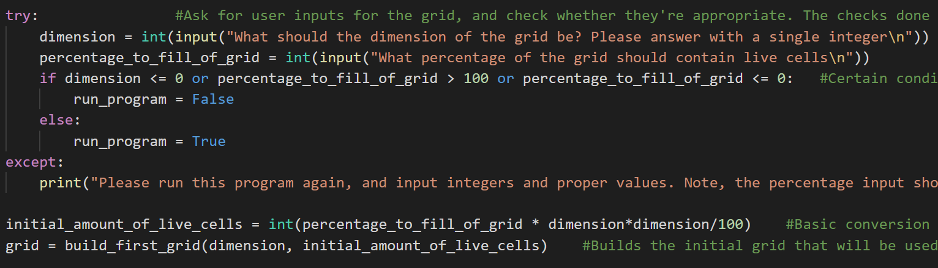
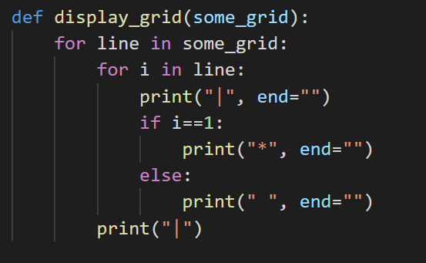
Displaying and Executing the Core Game
We take inputs from the user and do same basic validation of it
Conversion between percentage of grid of live cells, as inputted by the user, to an integer
The grid is built, as per the user's instructions
Display_grid function copied from website
Essentially, instead of displaying a whole bunch of 0s and 1s in lists within lists, it converts it into a more comprehensible and visual-friendly format

Slide 15
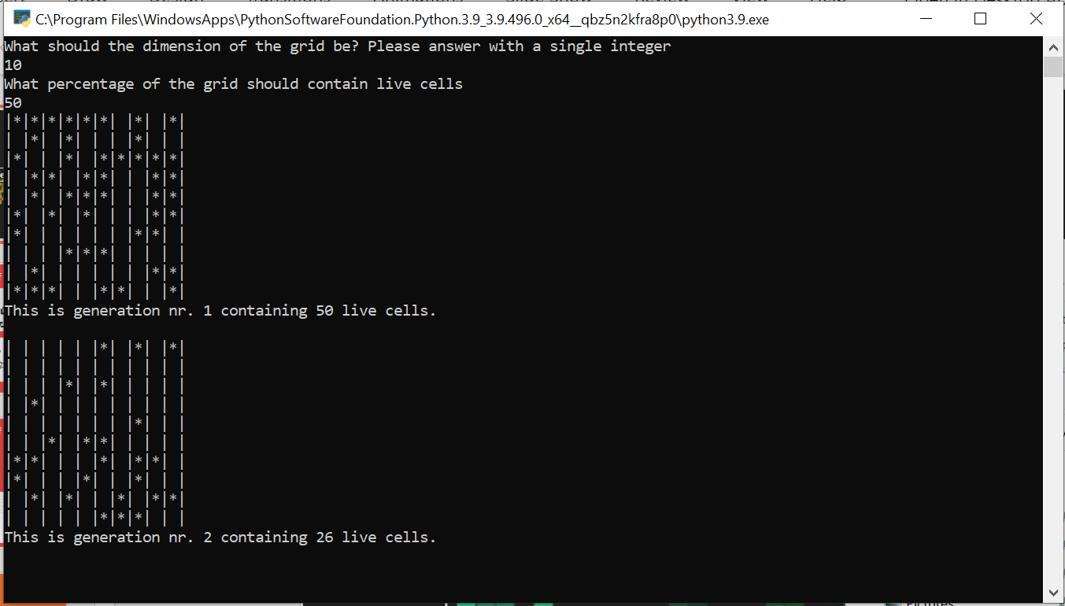
Displaying and Executing the Core Game
This is what a sample game looks like in the console window

Slide 16
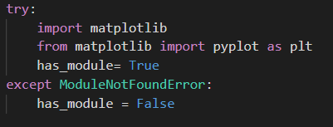
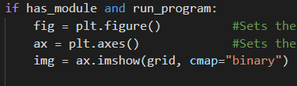
Animating the game with Matplotlib
Matplotlib is a Python module that is used to create various types of visualisations and plots using Python
Not a module that comes with Python, unlike random or time
We test whether the user has the module using a try/except block:
If the user has it, a variable, has_module, set to be True. Code checks this variable later to determine whether it should graph the game:

Slide 17
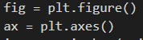
Animating the game with Matplotlib
We set the rudimentary plot up:
Use the .imshow() function to “map” the grid onto the plot:
Use the .FuncAnimation function from matplotlib.animation, to animate it

Slide 18
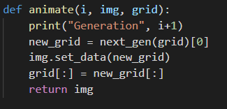
Animating the game with Matplotlib
Fig refers to the plot
Must make the animate function, to update the plot:
Returns a new “image” each time it’s called
Fargs contain the additional variables we must pass into animate() function
Interval sets the delay between each frame

Slide 19
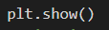
Animating the game with Matplotlib
Game_loop function with “display” set to false, used to determine how many frames the animation should run:
We set repeat to False, so it stops after having shown the animation
Now, the code shows the animation:

Slide 20
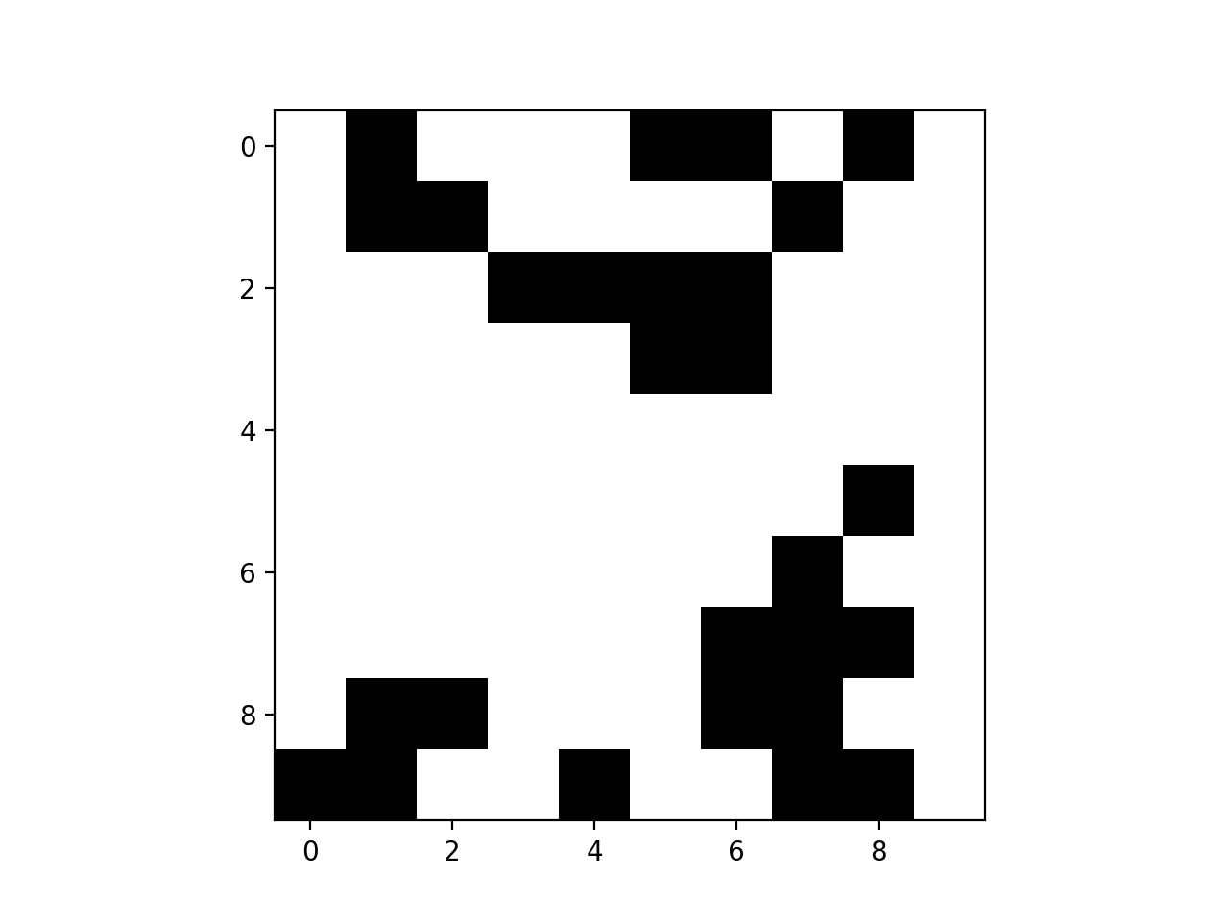
Demonstrations

Slide 21
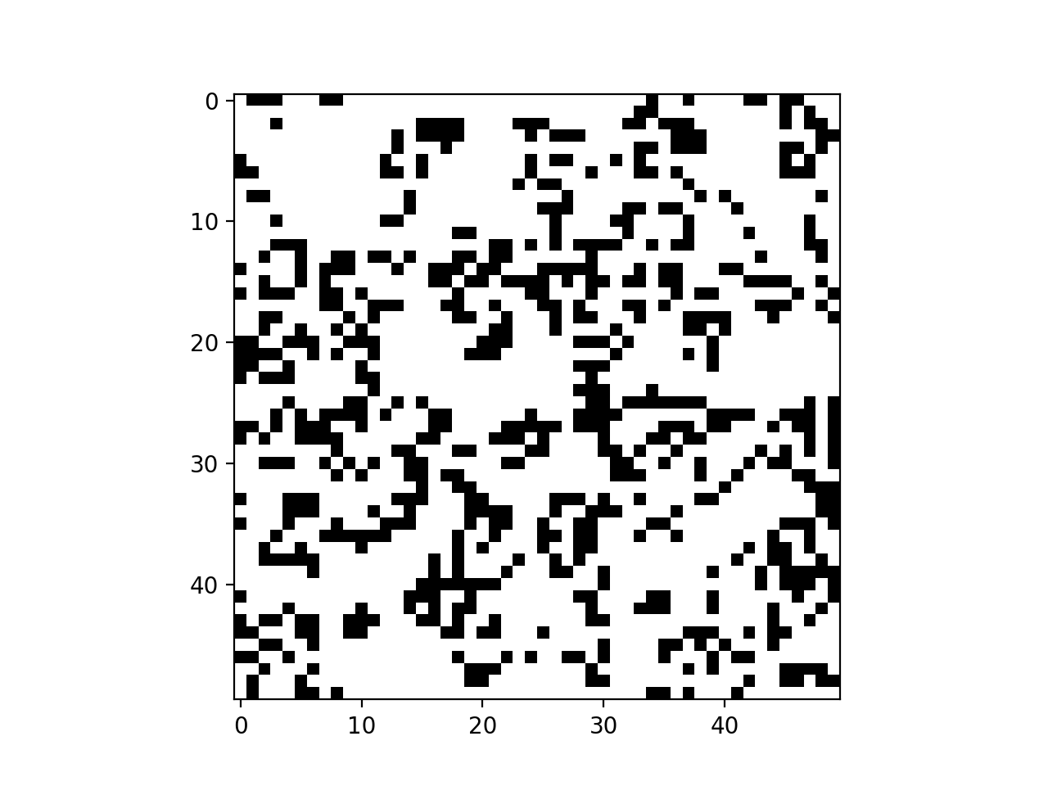
Demonstrations

